Slide 1
Statistics
Amrita Panjwani
Lead Data Scientist

Slide 2
What is Statistics?
Statistics is a mathematical science including methods of collecting, organizing and analyzing data in such a way that meaningful conclusions can be drawn from them. In general, its investigations and analyses fall into two broad categories called descriptive and inferential statistics.

Slide 3
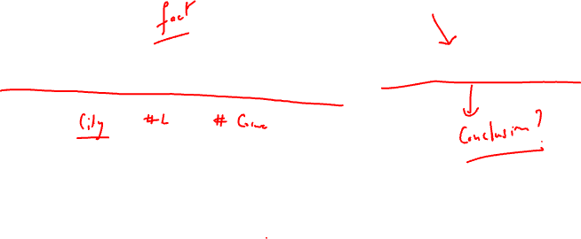
1. The more liquor shop in a city, the more crime there is. Thus, liquor shops lead to crime.

Slide 4
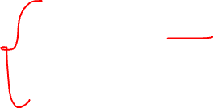
1. Flaw: A major flaw is that both increased liquor shops and increased crime rates can be explained by larger populations. In bigger cities, there are both more liquor shops and more crime. This problem refers to the third-variable problem. Namely, a third variable can cause both situations; however, people erroneously believe that there is a causal relationship between the two primary variables rather than recognize that a third variable can cause both.
Hence, the correct Interpretation of the numbers are necessary!!!!

Slide 5
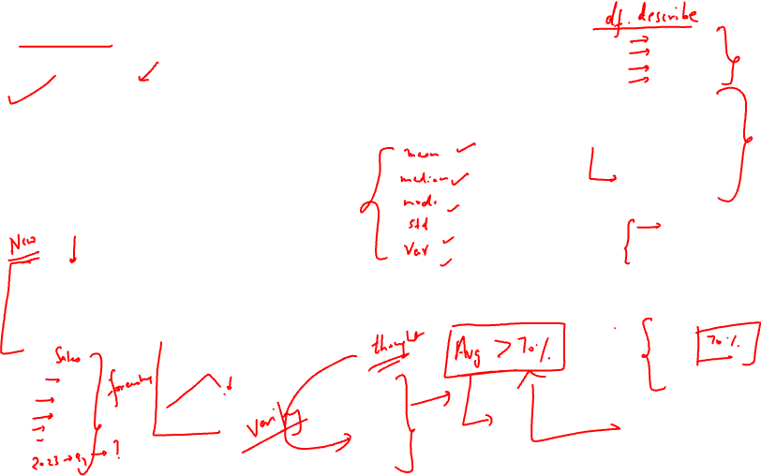
Types of Statistics:
1. Descriptive statistics deals with the processing of data without attempting to draw any inferences from it. The characteristics of the data are described in simple terms. Events that are dealt with include everyday happenings such as accidents, prices of goods, business, incomes, epidemics, sports data, population data.
2. Inferential statistics is a scientific discipline that uses mathematical tools to make forecasts and projections by analysing the given data. This is of use to people employed in such fields as engineering, economics, biology, the social sciences, business, agriculture and communications.

Slide 6
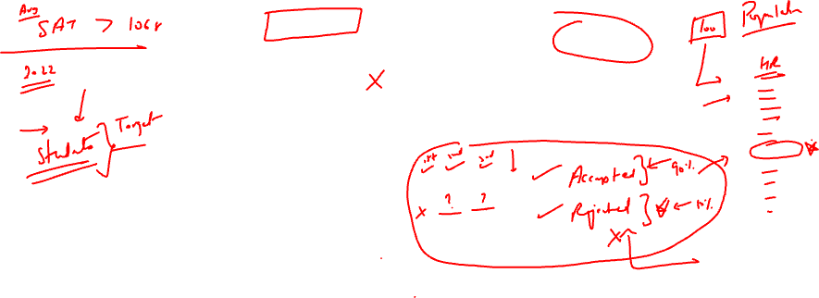
Population?
Refers to the total amount of things.
Sample?
Small part of population that is used for study.
Sample Size?
Total amount of things in a sample.
Variable?
What we are studying. (Measurable, Countable, Categorized)
Notes:
Variable: How a particular person can have different heights, weights and hair colour. These are variables. It refers to characteristics of what we are studying. Can vary among different individuals.

Slide 7
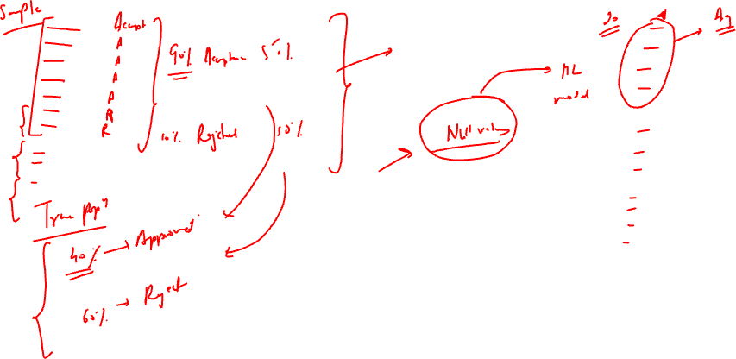
Example: Is the average SAT score 1068?

Slide 8
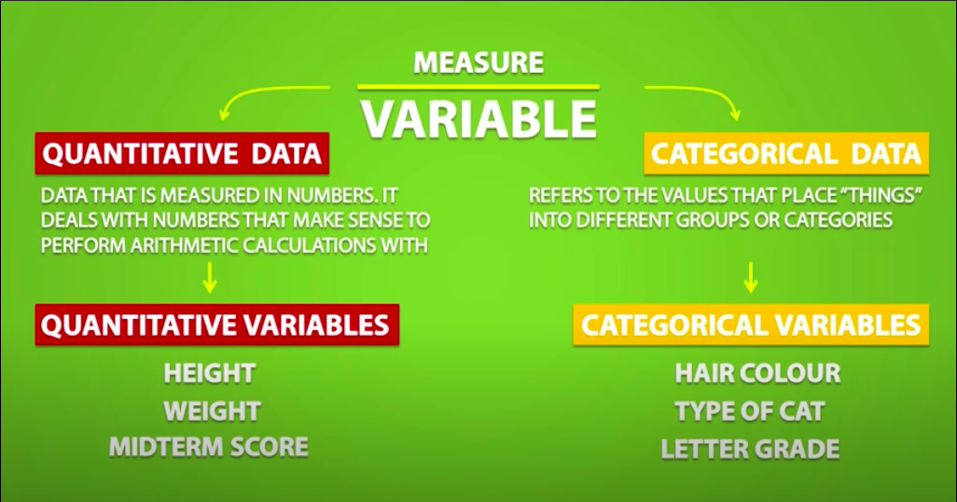
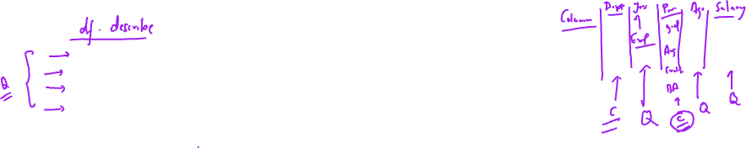

Slide 9
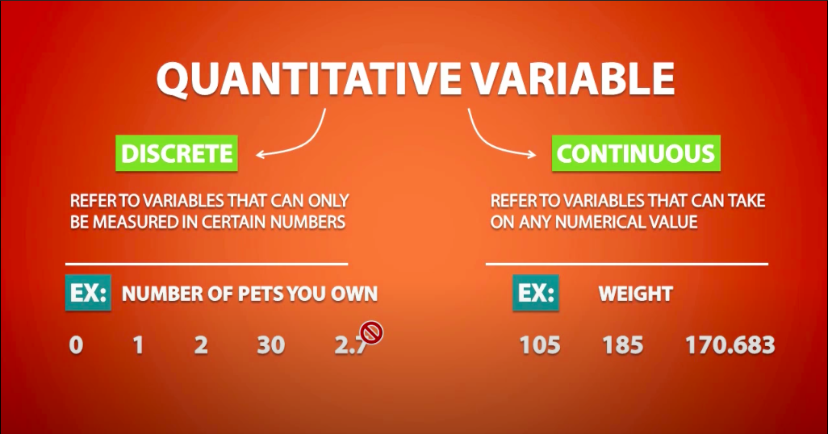
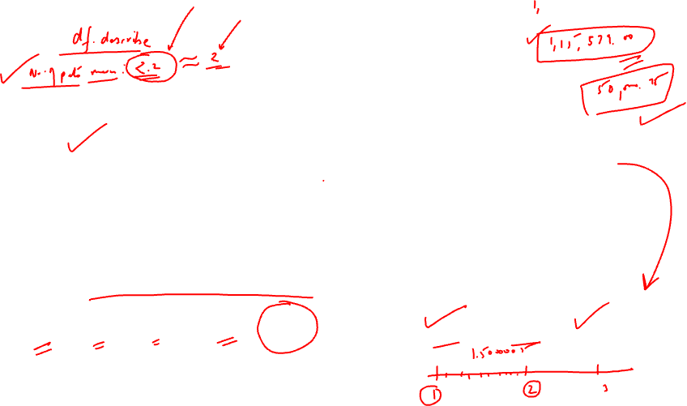

Slide 10
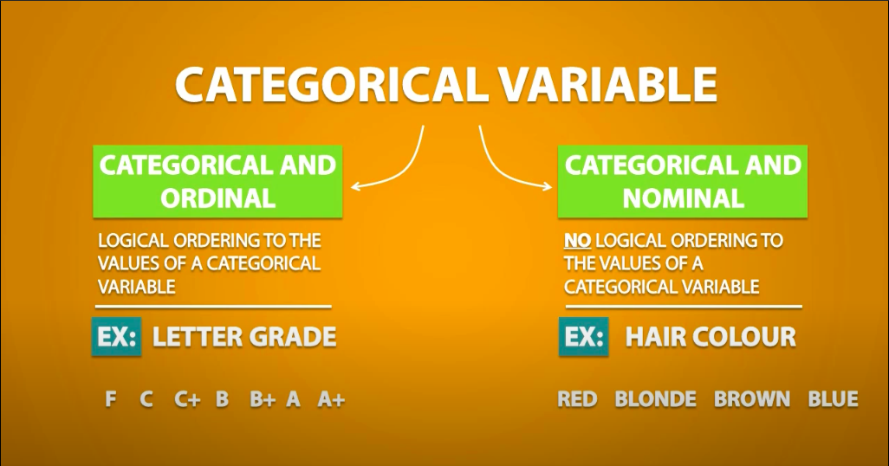
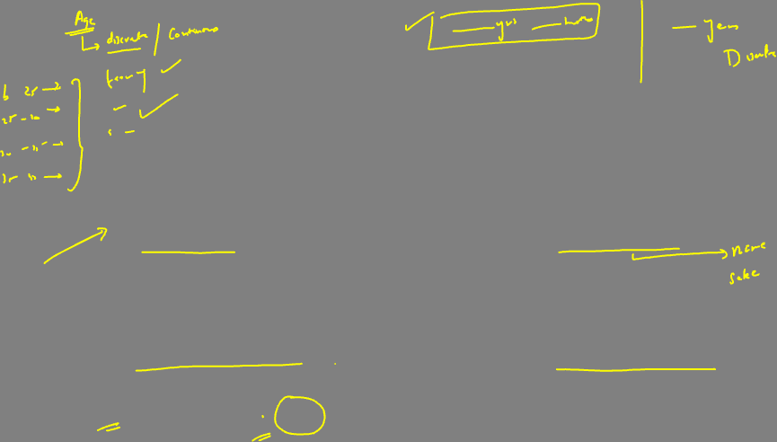

Slide 11
Data Visualization Basics
What is data Visualization?
Data visualization is the representation of data or information in a graph, chart, or other visual format. It communicates relationships of the data with images. This is important because it allows trends and patterns to be more easily seen.
What is its importance?
We need data visualization because a visual summary of information makes it easier to identify patterns and trends than looking through thousands of rows on a spreadsheet. It’s the way the human brain works.
Since the purpose of data analysis is to gain insights, data is much more valuable when it is visualized.
Even if a data analyst can pull insights from data without visualization, it will be more difficult to communicate the meaning without visualization.
Charts and graphs make communicating data findings easier even if you can identify the patterns without them.

Slide 12
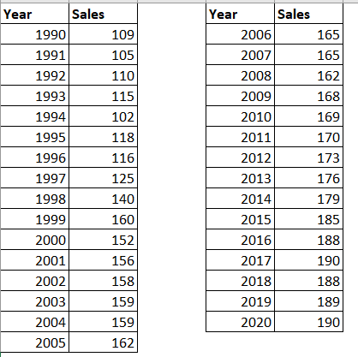

Slide 14
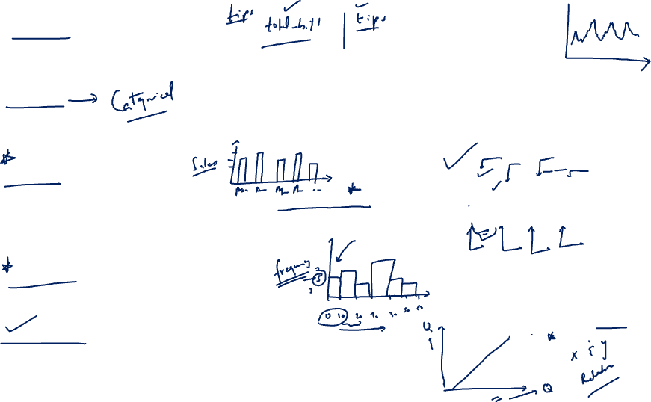
Line Chart.
A line chart is, as one can imagine, a line or multiple lines showing how single, or multiple variables develop over time.
Pie Chart.
A pie chart is a circular graph divided into slices. The larger a slice is the bigger portion of the total quantity it represents.
Bar Graph.
A bar chart or bar graph is a chart or graph that presents categorical data with rectangular bars with heights or lengths proportional to the values that they represent. The bars can be plotted vertically or horizontally. Can be of one variable or many variable.
Histogram
A series of bins showing us the frequency of observations of a given variable.
Scatter Plots
A scatter plot is a great indicator that allows us to see whether there is a pattern to be found between two variables. E.g. : Positive or negative relationship.

Slide 15
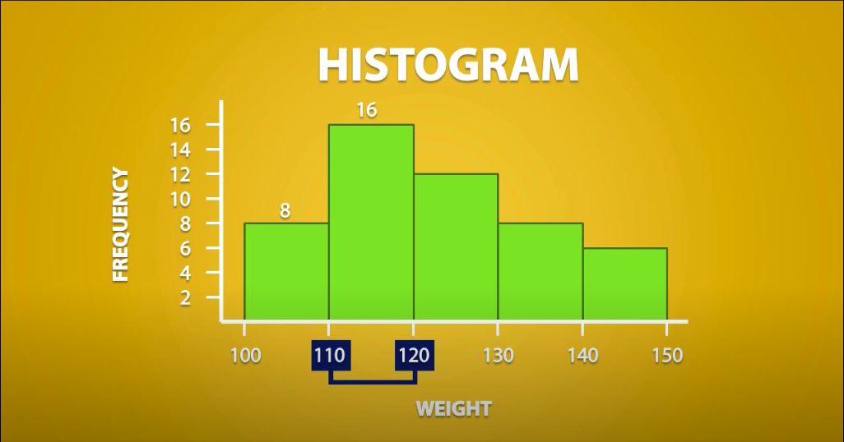
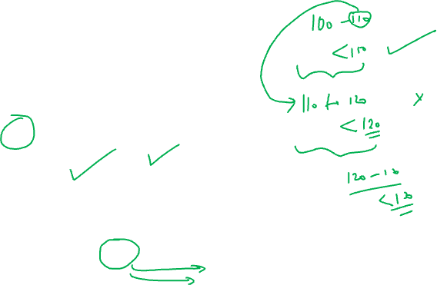

Slide 16

Types of charts
Name | Description
Line chart | Used for time series data
Bar chart | Used to compare different categories
Pie chart | Used to evaluate the share of each category
Histogram | Used for continuous data and reveals the distribution
Scatterplot | Used to evaluate relation between two variables

Slide 17
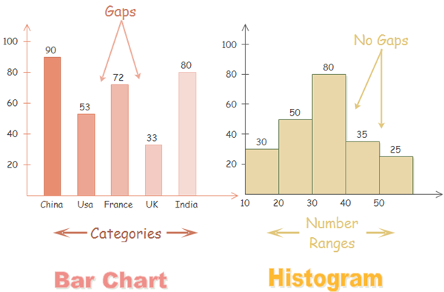
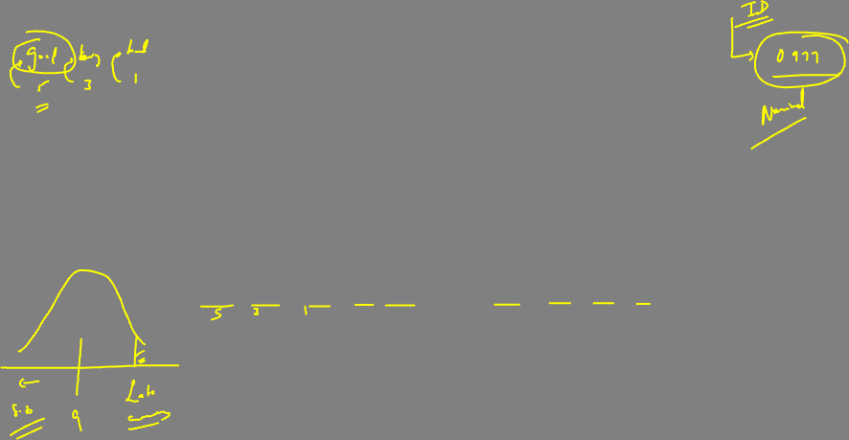

Slide 18

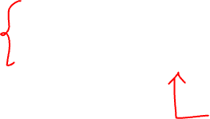
Descriptive Statistics
deals with the processing of data without attempting to draw any inferences from it. The characteristics of the data are described in simple terms. Events that are dealt with include everyday happenings such as accidents, prices of goods, business, incomes, epidemics, sports data, population data.
When we give description of data, there can be 3 kinds:
Measures of Central Tendency – Mean, Median and Mode
Measures of Dispersion – Standard Deviation, Variance, Range, IQR (Inter Quartile Range)
Measure of Symmetricity/Shape – Skewness and Kurtosis

Slide 19
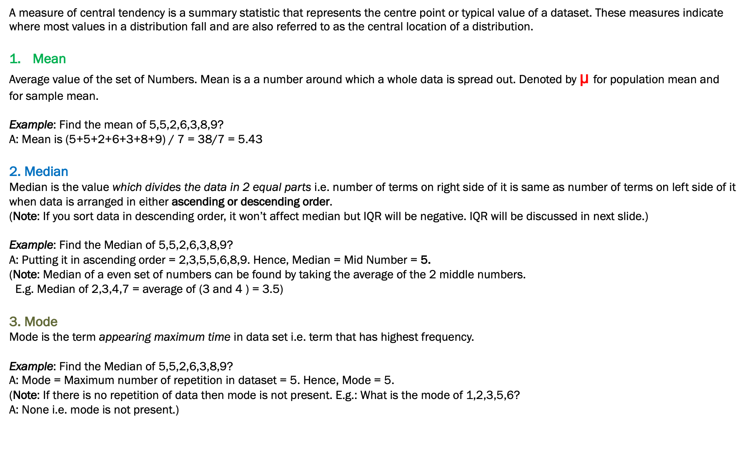
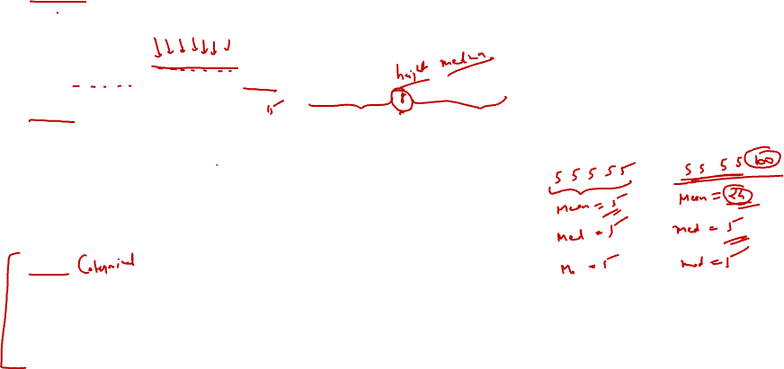
1. Measure of Central Tendency
A measure of central tendency is a summary statistic that represents the centre point or typical value of a dataset. These measures indicate where most values in a distribution fall and are also referred to as the central location of a distribution.
Mean
Average value of the set of Numbers. Mean is a a number around which a whole data is spread out. Denoted by µ for population mean and
for sample mean.
Example: Find the mean of 5,5,2,6,3,8,9?
A: Mean is (5+5+2+6+3+8+9) / 7 = 38/7 = 5.43
2. Median
Median is the value which divides the data in 2 equal parts i.e. number of terms on right side of it is same as number of terms on left side of it when data is arranged in either ascending or descending order.
(Note: If you sort data in descending order, it won’t affect median but IQR will be negative. IQR will be discussed in next slide.)
Example: Find the Median of 5,5,2,6,3,8,9?
A: Putting it in ascending order = 2,3,5,5,6,8,9. Hence, Median = Mid Number = 5.
(Note: Median of a even set of numbers can be found by taking the average of the 2 middle numbers.
E.g. Median of 2,3,4,7 = average of (3 and 4 ) = 3.5)
3. Mode
Mode is the term appearing maximum time in data set i.e. term that has highest frequency.
Example: Find the Median of 5,5,2,6,3,8,9?
A: Mode = Maximum number of repetition in dataset = 5. Hence, Mode = 5.
(Note: If there is no repetition of data then mode is not present. E.g.: What is the mode of 1,2,3,5,6?
A: None i.e. mode is not present.)

Slide 21
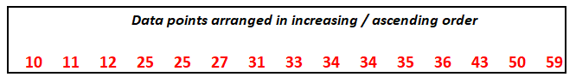
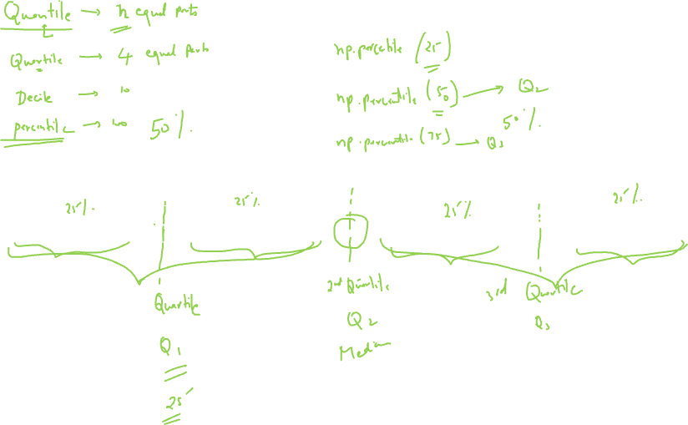

Slide 22

Let’s build some concepts before going ahead.
1. What is Minimum and Maximum value?
It is the minimum and Maximum values of the dataset respectively.
2. What is 1st and 3rd Quartile? – Also called the lower and upper quartile respectively.
When we divide the dataset into two groups while calculating median (sorted in ascending order), then the median of first half is 1st Quartile and median of second half is 3rd Quartile.
3. Then where is the 2nd Quartile?
Your median is the 2nd Quartile ;-)

Slide 23
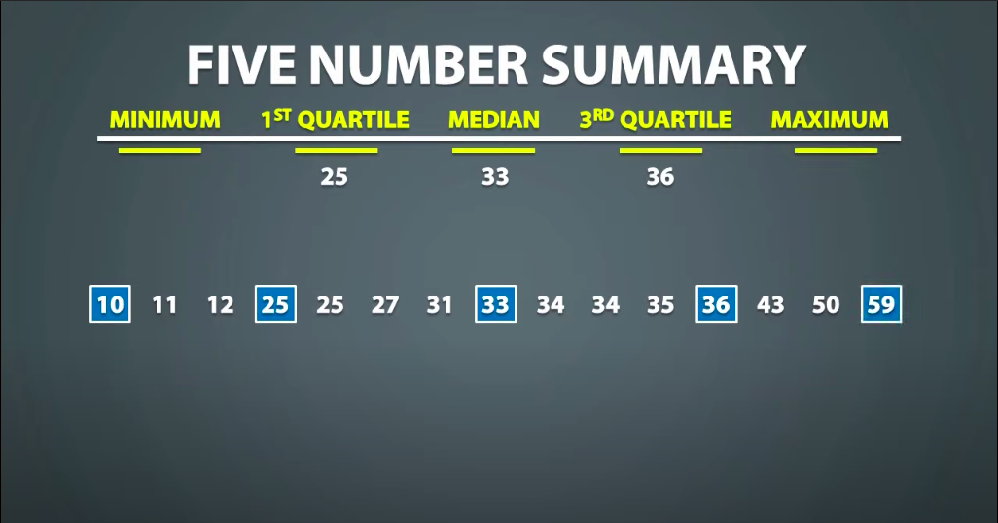



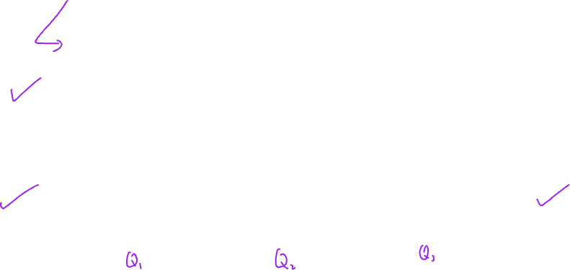

Slide 24
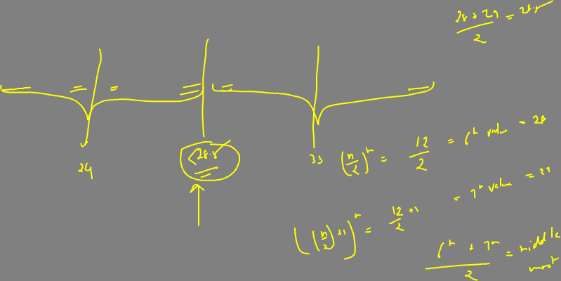
Q. Given is the ages of people registered for a webinar, calculate the 5 point summary (5 number summary) of
the ages of the participants?
19, 26, 25, 37, 32, 28, 22, 23, 29, 34, 39, 31
19, 22, 23, 25, 26, 28, 29, 31, 32, 34, 37, 39

Slide 25
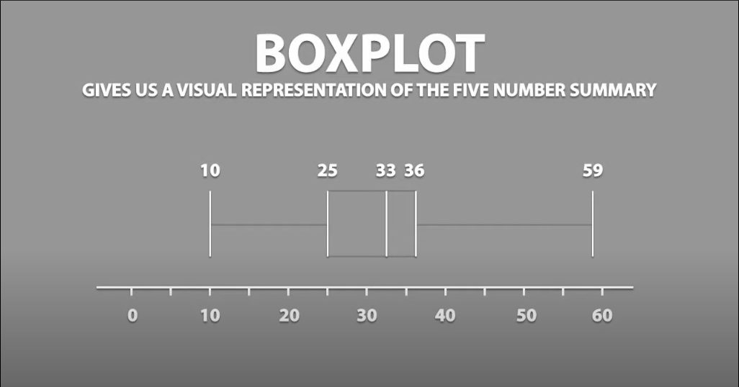

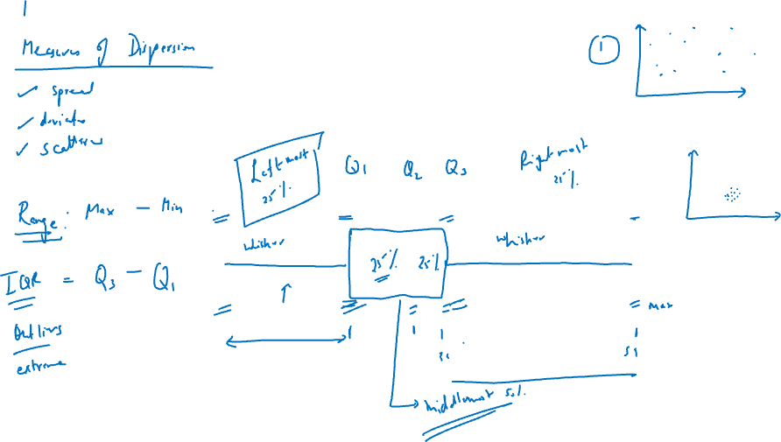

Slide 26
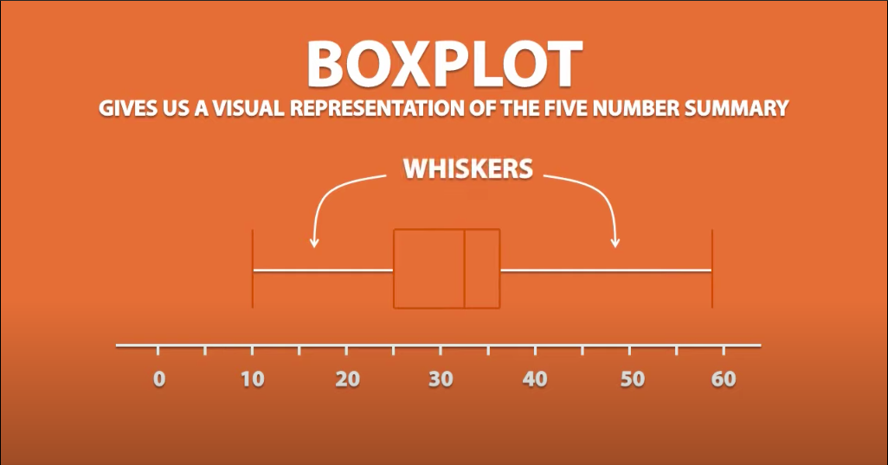

Slide 27
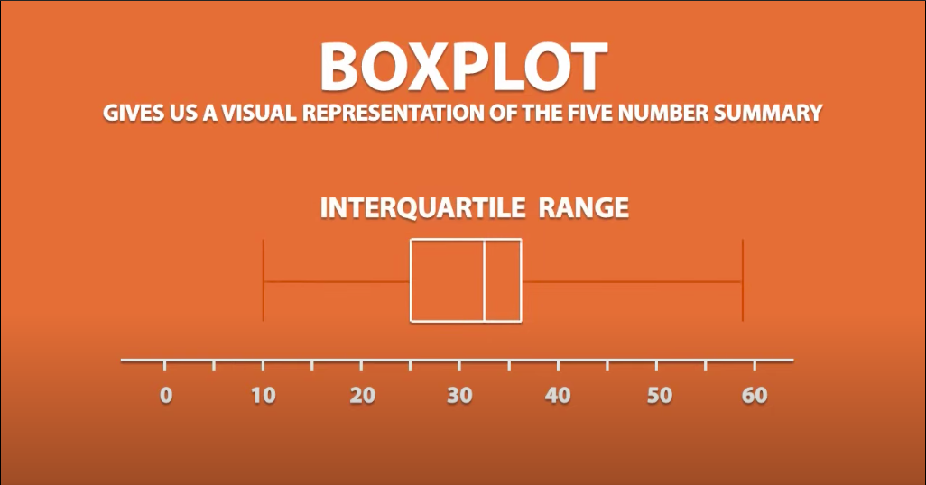
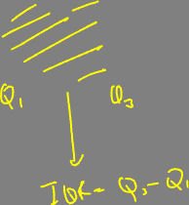

Slide 28
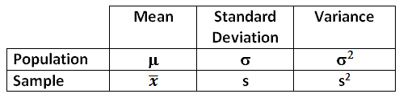
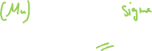

Slide 29
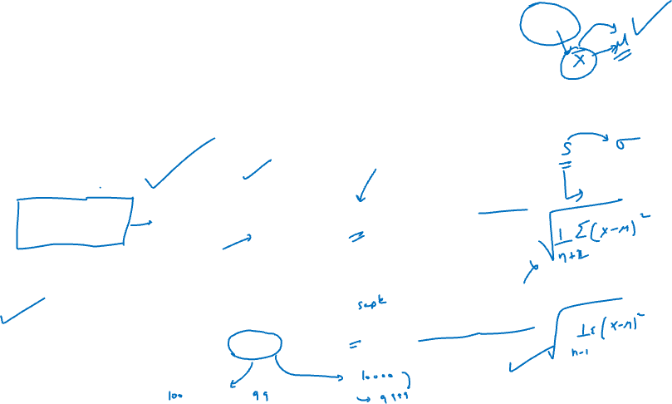
2. Measure of Spread / Dispersion
1. Standard deviation
Standard deviation is the measurement of average distance between each quantity and mean. That is, how data is spread out from mean. A low standard deviation indicates that the data points tend to be close to the mean of the data set, while a high standard deviation indicates that the data points are spread out over a wider range of values.
In Python :
Population STD = pstdev()
Sample STD = stdev()
SD of Population
(σ)
i
SD of Sample
(s)
i

Slide 30
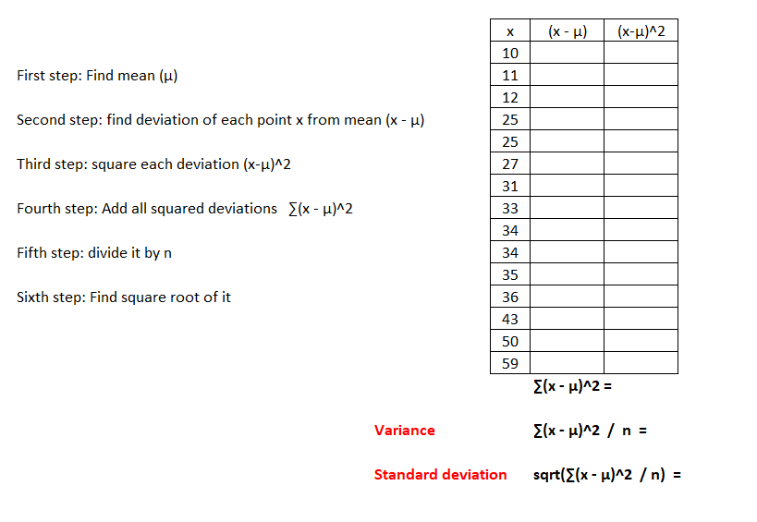
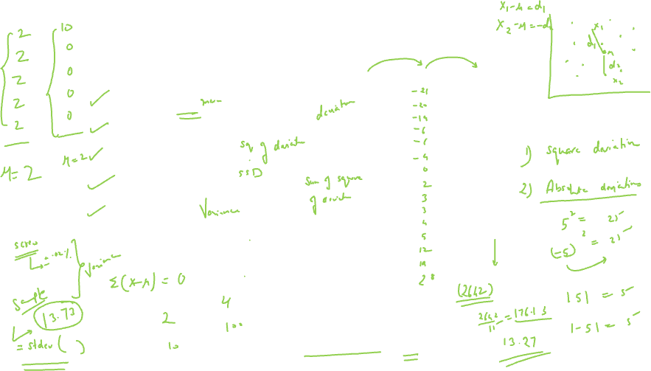

Slide 31

Measure of Spread / Dispersion
2. Variance
Variance is a square of average distance between each quantity and mean. That is, it is square of standard deviation.
In Python : Population Var = pvariance() Sample Variance = variance()
3. Range
Range is one of the simplest techniques of descriptive statistics. It is the difference between lowest and highest value.
Range = Maximum - Minimum
4. IQR (Interquartile Range)
In statistics and probability, quartiles are values that divide your data into quarters provided data is sorted in an ascending order.
IQR = Q3 – Q1
Population Variance
(σ²)
Sample Variance
(S²)
i
i

Slide 32
3. Measure of symmetricity – Skewness and Kurtosis

Slide 33
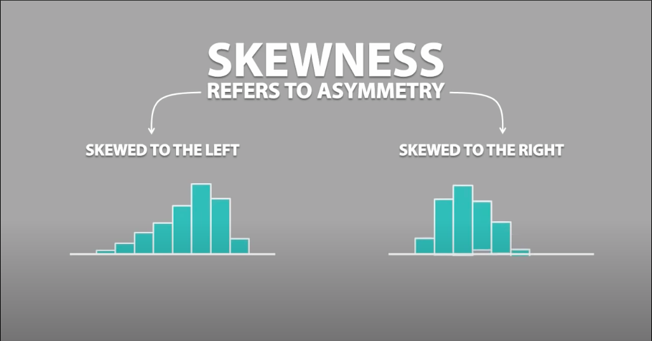
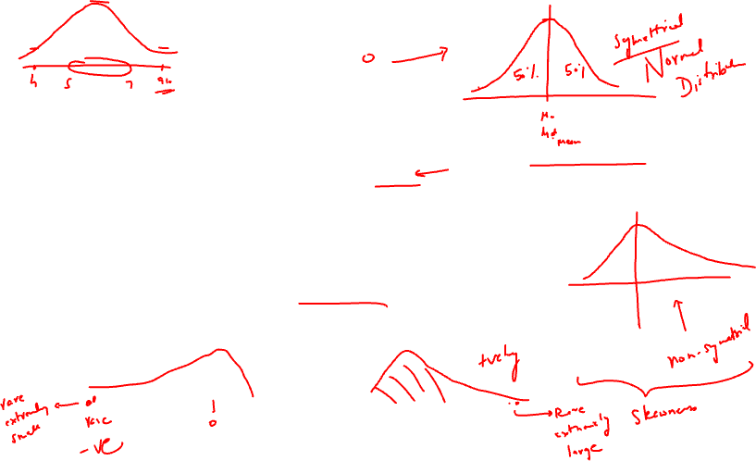
1. Skewness
Skewness is usually described as a measure of a dataset’s symmetry – or lack of symmetry.
A perfectly symmetrical data set will have a skewness of 0.
The normal distribution has a skewness of 0.

Slide 34
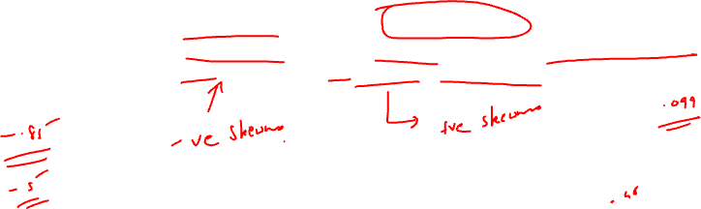
Skewness
So, when is the skewness too much? The rule of thumb seems to be:
If the skewness is between -0.5 and 0.5, the data are fairly symmetrical.
If the skewness is between -1 and – 0.5 or between 0.5 and 1, the data are moderately skewed.
If the skewness is less than -1 or greater than 1, the data are highly skewed.

Slide 35
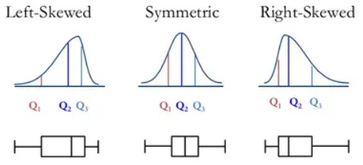


Slide 36
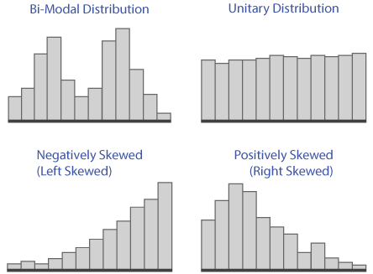
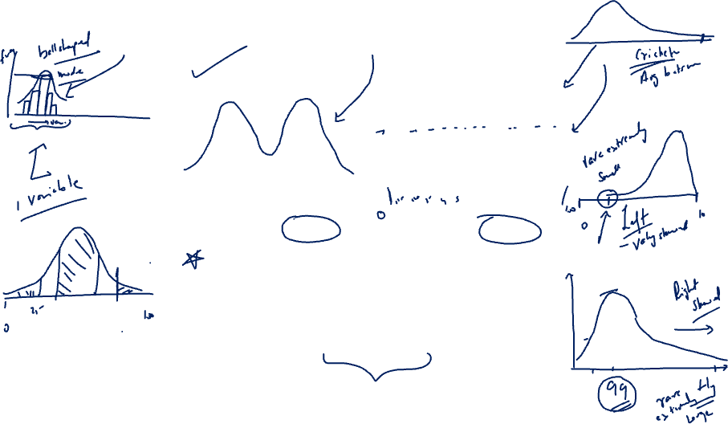

Slide 37
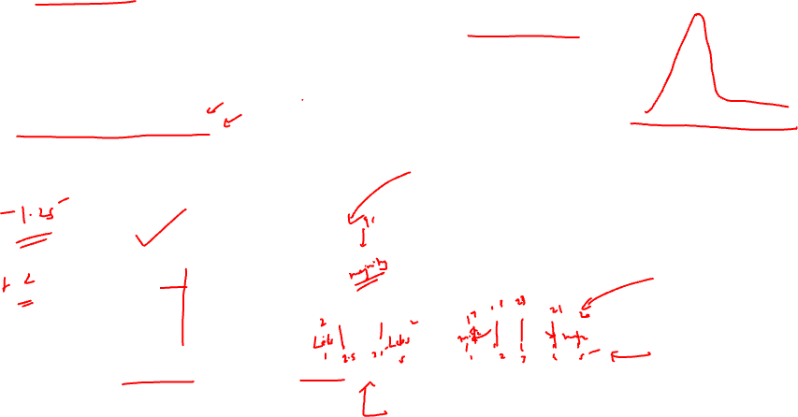
2. Kurtosis
Kurtosis is all about the tails of the distribution. It measures the tail-heaviness of the distribution. Kurtosis is calculated as:
import numpy as np
from scipy.stats import kurtosis
x = np.random.normal(0, 2, 10000) # create random values based on a normal distribution
print(kurtosis(x))

Slide 38
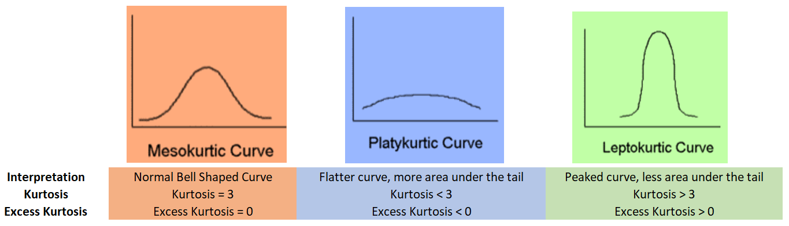
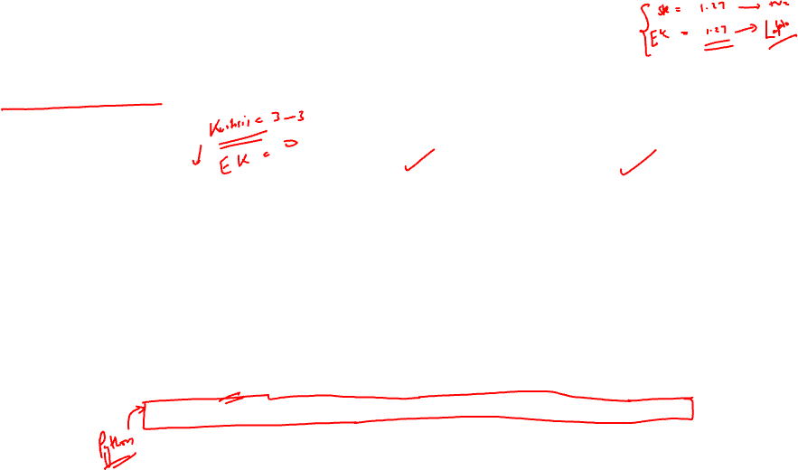

Slide 39
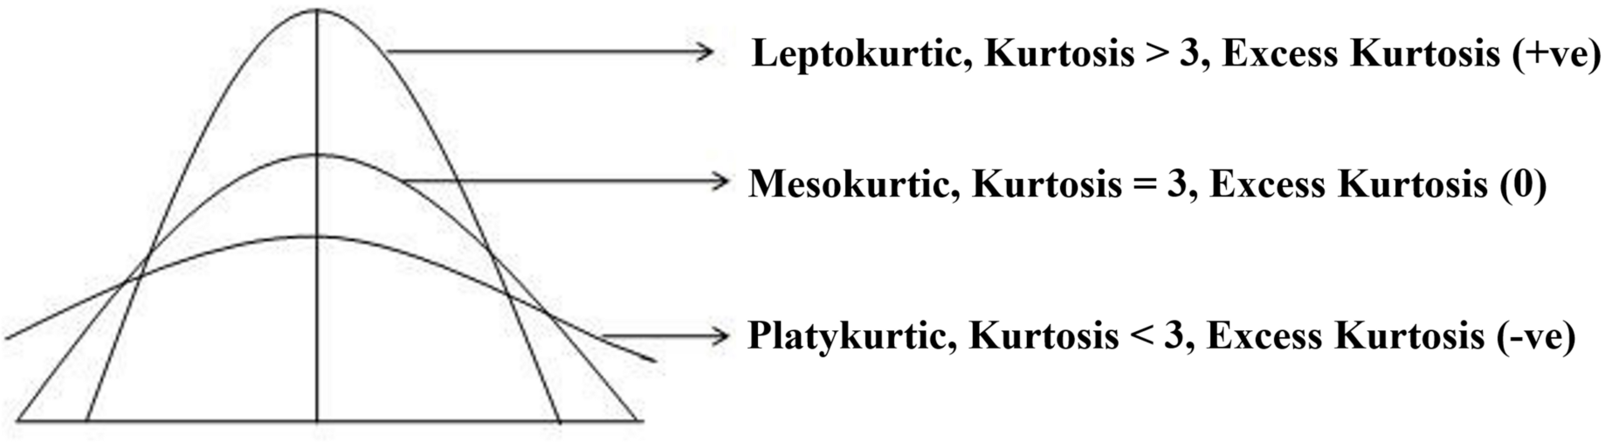


Slide 40
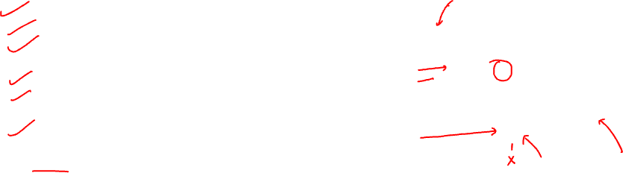
Outliers
What is outlier?
An outlier is an observation that lies an abnormal distance from other values in a random sample from a population. In a sense, this definition leaves it up to the analyst to decide what will be considered abnormal.
Common Causes of Outliers
Data entry errors (human errors)
Measurement errors (instrument errors)
Experimental errors (data extraction or experiment planning/executing errors)
Intentional (dummy outliers made to test detection methods)
Data processing errors (data manipulation or data set unintended mutations)
Sampling errors (extracting or mixing data from wrong or various sources)
Natural (not an error, novelties in data)

Slide 41
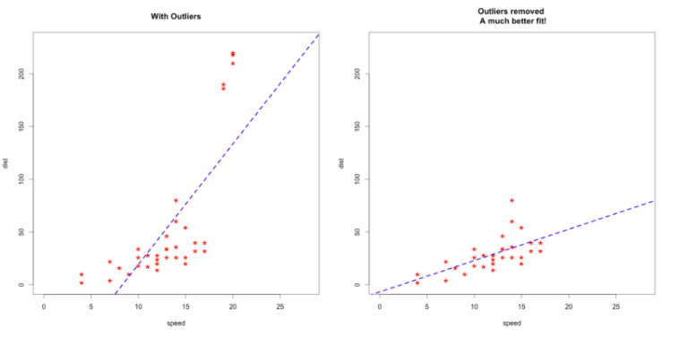
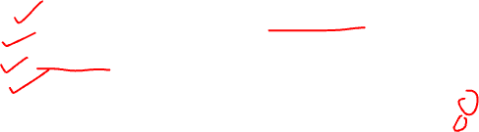
Common methods of determining an Outlier
1. Sort the data and see for the extreme values
2. Plotting – Boxplot, Scatterplot
3. IQR Method
4. Z-Score Method
Why do we need to treat outliers?
Outliers can impact the results of our analysis and statistical modelling in a drastic way.

Slide 42
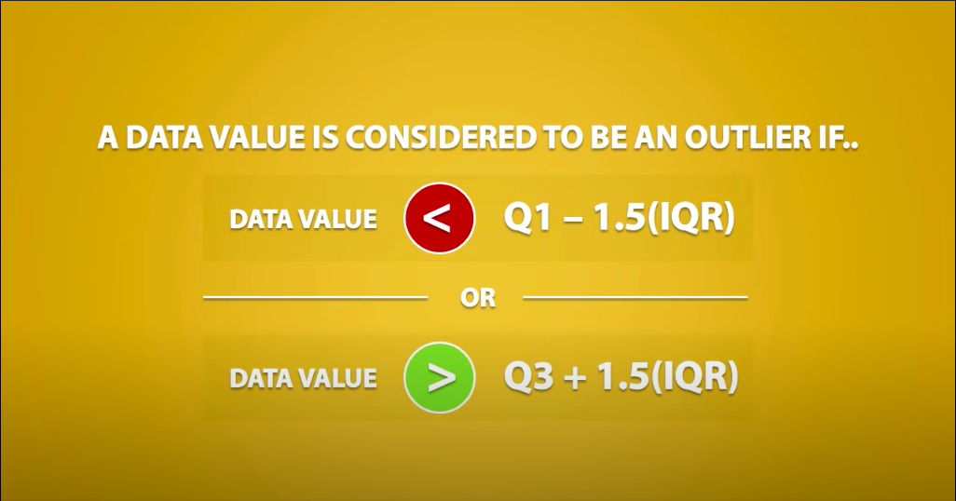
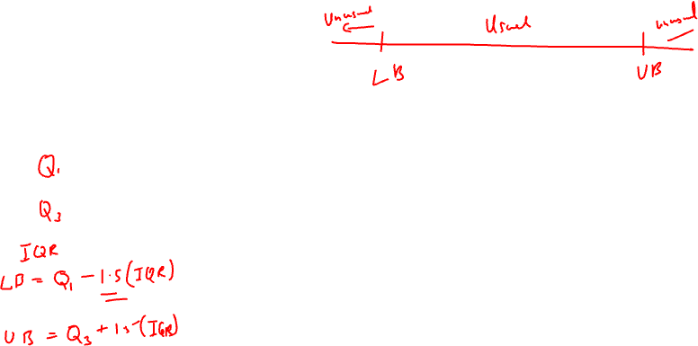
IQR Method

Slide 43


Slide 44



Outliers < Q1 – 1.5 (IQR)
> Q3 + 1.5 (IQR)
25 – 1.5 (11) = 8.5
36 + 1.5 (11) = 52.5
Hence, we can say that 59 is the only outlier we have in our dataset.

Slide 45



Slide 46


Z-Score Method
What is Z-Score?
Z-scores can quantify the unusualness of an observation when your data follow the normal distribution. Z-scores are the number of standard deviations above and below the mean that each value falls, assuming a Normal distribution.
For example, a Z-score of 2 indicates that an observation is two standard deviations above the average while a Z-score of -2 signifies it is two standard deviations below the mean.
Z-Score Formula?

Slide 47

Example: Consider the below dataset. Find out the outlier using Z-score method.
1, 2, 2, 2, 3, 1, 1, 15, 2, 2, 2, 3, 1, 1, 2
Solution:
Mean = 2.66
Std = 3.36
Ref:
Z score formula =
Z (1) = (1 – 2.66)/3.36 = -0.49405
Z(2) = (2 – 2.66)/3.36 = -0.19643
Z(3) = (3 – 2.66)/3.36 = 0.10119
Z(15) = (15 – 2.66)/3.36 = 3.67262
We will term the point outlier if it has a z-score of 3 or above (in any side - positive or negative).
Hence, here the outlier is 15.

Slide 48



Covariance

Slide 49

Covariance
It is a metric which is used to measure the direction of relationship between two random variables and evaluates how two variables change together.
Difference between variance and covariance lies in the fact that variance measures how one variable varies, however, covariance measures how two variables vary with respect to each other. In other words, variance tells the covariance of variable with itself.
Covariance can take up any value from (-) infinity to (+) infinity and gives the direction of relationship between two variables.
One important point to note here is that it only measures how two variables change together.
In Python: use cov() function

Slide 50


Correlation

Slide 51


What is Correlation?
Correlation is a statistical technique to depict the relationship between 2 variables – strength and direction. We measure the correlation with the help of Correlation Coefficient.
For example, height and weight are related; taller people tend to be heavier than shorter people.
What is Correlation Coefficient?
The Pearson’s correlation coefficient (r) is a measure that determines the degree to which the movement of two variables is associated. The value of Correlation Coefficient lies between -1 and 1.

Slide 52

Positive and Negative Correlation:
Correlation Coefficient greater than zero indicates a positive relationship
2. while a value less than zero signifies a negative relationship
3. and a value of zero indicates no relationship between the two variables being compared.

Slide 53

Strong and Weak Correlation:
Kind of correlation = depicted by sign of correlation coefficient
Strength = magnitude of Correlation Coefficient ( r )

Slide 54


Formula: (Pearson’s Correlation Coefficient) - Standard Formula
In Python: DataFrame.corr(method=’pearson’)
Where:
n = sample size
Sx, Sy are the standard deviation of samples x and y
X-bar and y-bar are the respective means of x and y samples
Xi and Yi are sample points of X and Y respectively

Slide 55



Slide 56


X bar = y bar = Sx = Sy = n =

Slide 57



Slide 58


Spearman Rank Correlation
Used for Non-Linear Variables
Spearman Corr Coeff = Pearson Corr coeff (rank varaibles)
In Python: DataFrame.corr(method=’spearman’)
Denoted by rho.

Slide 59

Steps for Spearman Correlation Coefficient
Create a new column for rank(x) and assign the rank of each variable.
Assign the rank of 2nd variable in a new column rank(y).
Calculate the difference in rank of both the variables = d.
Calculate the d-squared.
Add up d-squared score.
Put in the formula provided:

Slide 60


Question: The scores for 10 students in English and Maths are as follows:
Compute the Spearman rank correlation.

Slide 61


Solution:
Step 1,2,3 and 4:

Slide 62

Solution Contd.
Step 5:
Step 6:
Hence, the Spearman Rank Coefficient is 0.67.

